Slide 1
Introduction to Basic Statistical Analysis
R workshop
Zanele Nhlabatsi (PhD, MPH) and Abigail Seeger (MS)

Slide 2
TABLE OF CONTENTS
Welcome and Goals of the Session
To build a foundational understanding of key statistical tests used in research
What We Will Cover:
Descriptive statistics
t-tests
Chi-squared tests
Correlation
ANOVA
Why these tests are useful in research

Slide 3















EXPOSURE
OUTCOME
Predictor
Risk factor
Disease
Death
COVID
Disease
COVID Disease
Mortality by COVID
COVID Vaccine
Exposure
Outcome
Exposure
Outcome

Slide 4












Exposure and Outcome - Examples
EXPOSURE
OUTCOME
Predictor
Risk factor
Disease
Death
HIV and Viral Hepatitis Transmission Knowledge among Female Health Care Providers and Females in the General Population in Constanta Region, Romania
A Quality Improvement Initiative to Close Gaps in Attaining the Third UNAIDS 95-95-95 Target among Children 0-4years and Adolescents 15- 19 years of Age at 3 Clinic Sites in Eswatini
Fast Tracking of Clients at Botswana Baylor Children's Clinical Centre of Excellence (BBCCCOE), Gaborone, Botswana
Being a Female Health Care Provider
HIV and Hepatitis Transmission Knowledge
Viral Load
Fast Tracking
Viral Load
Quality Improvement Initiative
Exposure
Outcome
Exposure
Outcome
Exposure
Outcome

Slide 5
Descriptive Statistics Refresher
Understanding your data first
Types of variables: categorical vs numerical
Common summary stats: mean, median, standard deviation
Importance of checking assumptions before analysis

Slide 6
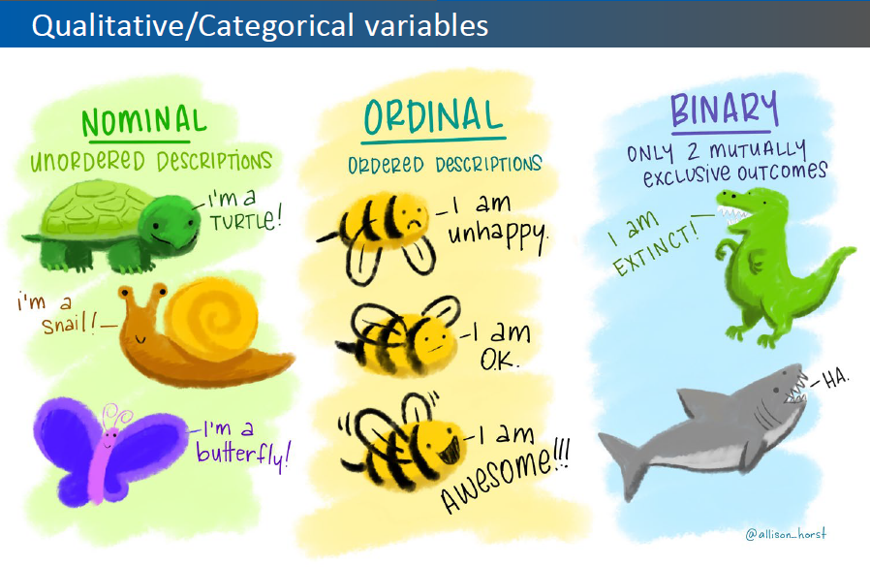
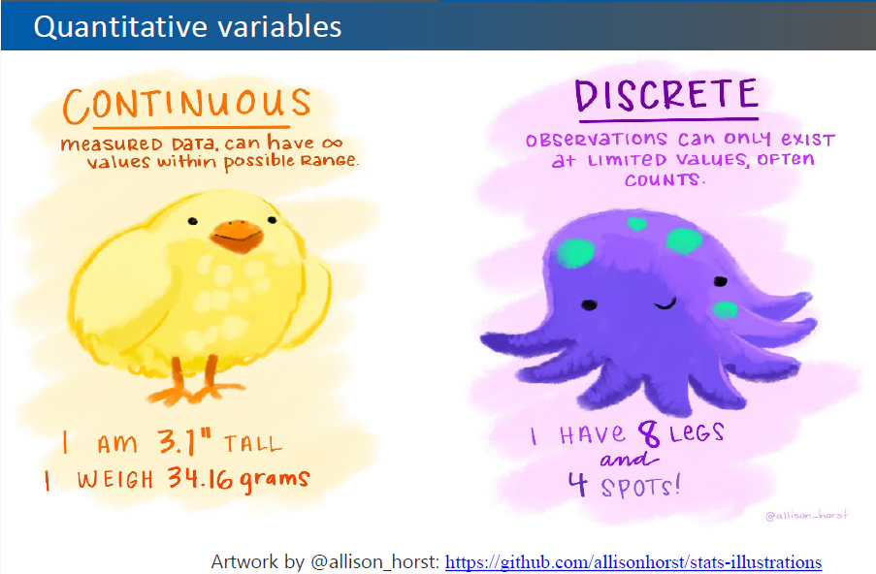
Types of variables

Slide 7
Hypothesis testing
Null Hypothesis (H₀): There is no association between the exposure and outcome. e.g., Smoking is not associated with lung cancer.
Alternative Hypothesis (H₁): There is an association between the exposure and outcome. e.g., Smoking increases the risk of lung cancer.
Goal: Use statistical testing to decide whether to reject H₀.

Slide 8
What Does the P-Value Tell Us?
Definition:
The p-value is the probability of observing a test statistic as extreme as, or more extreme than, the one observed — assuming the null hypothesis (H₀) is true.
How to Interpret:
Common Misconceptions:
🚫 "A p-value of 0.05 means there's a 5% chance the null hypothesis is true.”
✅ Wrong. P-value is not the probability that H₀ is true — it’s the probability of the data given H₀ is true.
🚫 "Statistical significance = clinical or practical significance.”
✅ Not necessarily. A statistically significant result may not be meaningful in practice.
P-value | Interpretation
p < 0.05 | Reject H₀ — statistically significant
p ≥ 0.05 | Do not reject H₀ — not statistically significant

Slide 9
Understanding Confidence Intervals
What is a Confidence Interval (CI)? A range of values, derived from sample data, that is likely to contain the true population parameter (e.g., mean, proportion) with a certain level of confidence (commonly 95%).
Key Elements:
Point Estimate: The sample statistic (e.g., sample mean)
Margin of Error: Accounts for variability; wider intervals reflect more uncertainty
Confidence Level: Often 95%, meaning if the study were repeated many times, 95% of the calculated intervals would contain the true value.
Why it’s useful:
Provides more information than a single point estimate
Helps assess precision and reliability of the estimate
Widely used in reporting results of hypothesis tests and research findings

Slide 10
What is a t-test?
t-Tests: Comparing means between two groups
Groups Types:
1-sample t-test
Independent samples t-test
Paired samples t-test
Example of an independent samples t-test: is there a difference in respiratory rates between genders among children?

Slide 11
Assumptions of t-tests
When is a t-test appropriate?
Data is numeric and continuous
Data is normally distributed (check with histogram*)
Equal variances (check with histogram**)
* an alternative way to check normality is the Shapiro-Wilk test
** an alternative way to check equal variances is the Levene test

Slide 12
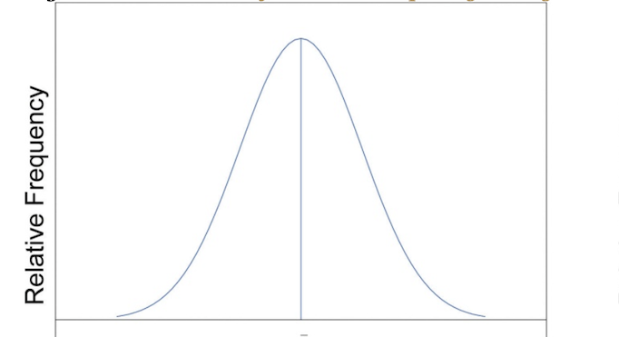
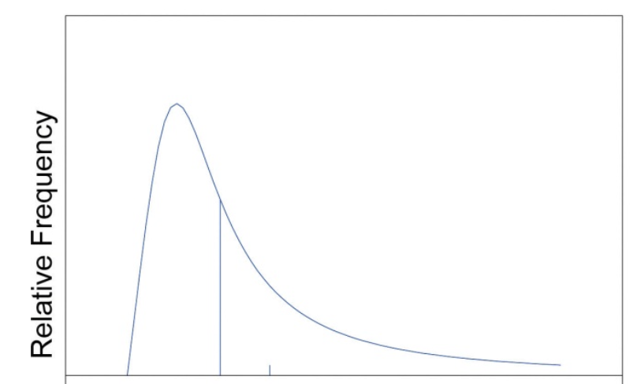
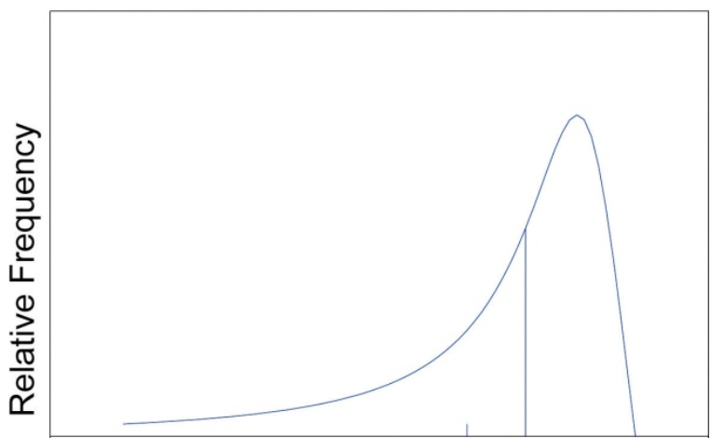
Distribution of data
Normal distribution
Skewed to the right
Skewed to the left

Slide 13
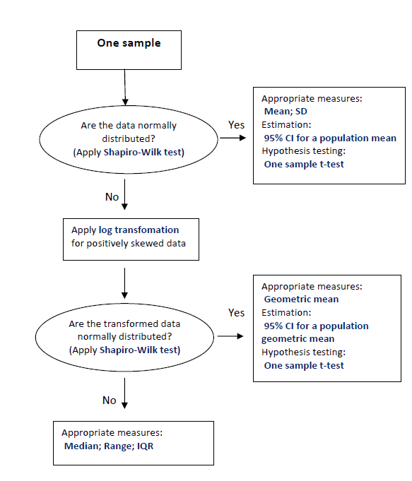
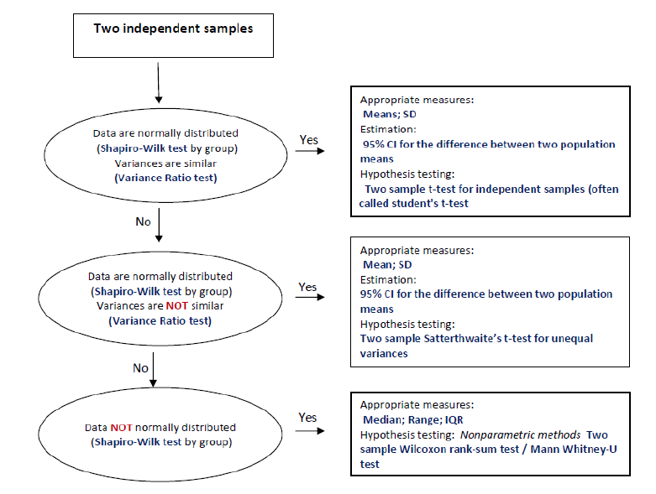

Slide 14
Wilcoxon rank sum test
What it is: A non-parametric test used to compare two independent groups when data are not normally distributed or when variances are unequal.
What it tests: Whether the distributions (typically the medians) of the two groups differ significantly.
When to use:
Data are ordinal or continuous, but not normally distributed
Unequal variances or outliers are present
Small sample sizes where normality cannot be assumed
Wilcoxon Rank Sum Test | Independent t-test
Non-parametric | Parametric
Compares ranks | Compares means
No assumption of normality or equal variances | Assumes normal distribution and equal variances
More robust to outliers | Sensitive to outliers

Slide 15
Head over to R

Slide 16
What is a Chi-squared Test?
Chi-squared Test: Comparing categories
Purpose: Compare observed frequencies to expected frequencies
Suitable for two categorical variables
Example: Is there an association between age category and categorical CD4 (<=200 and >200)?

Slide 17
Assumption for a Chi-squared test
1. Independence of Observations
Each observation must be independent of the others (i.e., no individual should appear in more than one category).
This generally means your data should come from a random sample.
2. Categorical Variables
The test is designed for categorical (nominal or ordinal) data, not continuous variables.
3. Expected Frequency
Expected frequencies in each cell should be at least 5 for the Chi-squared approximation to be reliable.
If any expected count is less than 5, consider using Fisher's Exact Test (for 2×2 tables) or collapsing categories.
4. Sample Size
The overall sample size should be sufficiently large to justify using the Chi-squared approximation.

Slide 18
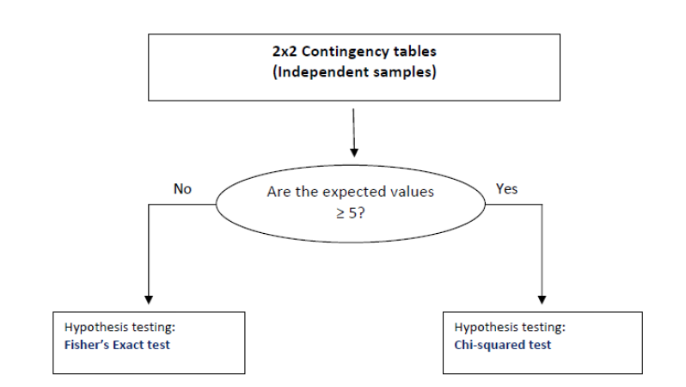

Slide 19
Head over to R

Slide 20
What is Correlation?
Correlation: Measure strength and direction of a linear relationship between two numeric variables
Values range from -1 (perfect negative) to +1 (perfect positive)
Example: What is the correlation between weight and height among adults?

Slide 21
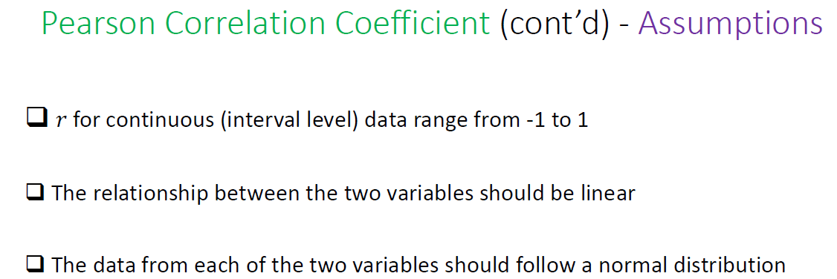

Slide 22
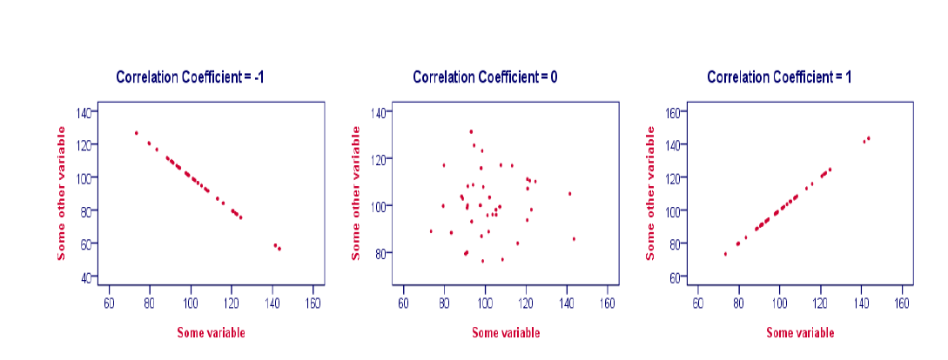
Pearson Correlation Coefficient (cont’d) Effect size and direction

Slide 23
Include Spearman correlation info
What is Spearman Correlation?
A non-parametric measure of rank correlation.
Assesses the strength and direction of the association between two variables based on ranked values.
Used when data are not normally distributed or are ordinal.
When to Use It:
Variables are ordinal, non-linear, or not normally distributed
Data contains outliers or violates assumptions of Pearson correlation

Slide 24
Interpretation of correlation values
Correlation Value | Strength of Association
1.00 to 0.80 | Strong positive
0.79 to 0.50 | Moderate positive
0.49 to 0.00 | Weak/no positive
0.00 to –0.49 | Weak/no negative
–0.50 to –0.79 | Moderate negative
–0.80 to –1.00 | Strong negative

Slide 25
Head over to R

Slide 26
What is ANOVA?
ANOVA: Comparing More Than Two Groups
Purpose: Compare means across 3 or more groups
Significant result → at least one group mean is different
Example: Is there a difference in CD4 count between the three countries?

Slide 27
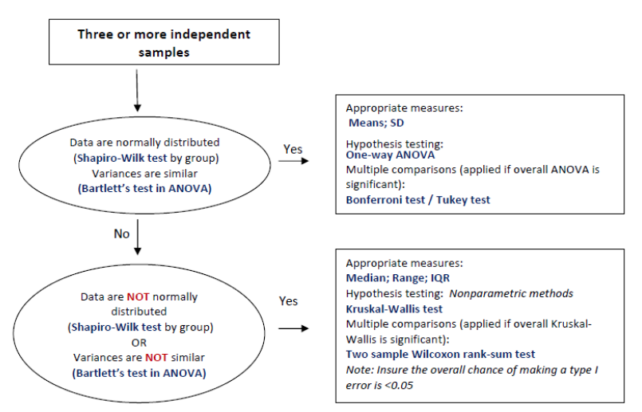

Slide 28
Head over to R

Slide 29

OUTCOME
 | BINARY (2 categories) | CATEGORICAL (more than 3) | CONTINUOUS
BINARY (2 categories) | P: Chi-Squared NP: Fisher’s Exact | P: Chi-Squared NP: Fisher’s Exact | P: T-test NP: Wilcoxon’s / Mann Whitney
CATEGORICAL (more than 3) | P: Chi-Squared NP: Fisher’s Exact | P: Chi-Squared NP: Fisher’s Exact | P: ANOVA NP: Kruskal Wallis
CONTINUOUS | P: T-test NP: Wilcoxon’s / Mann Whitney | P: ANOVA NP: Kruskal Wallis | Pearson Correlation
EXPOSURE
P = Parametric – Assumes a normal distribution of the variables involved
NP = Non-Parametric – Does not assume normal distribution of the variables involved
Research Question
Subjects / Observations
Variables / Measurements
Statistical Analysis
Study Design
Errors

Slide 30
Acknowledgements
Kai Lockhart
Anna Mandalakas, Anca Vasiliu, and Joanna Ehrlich

Slide 31
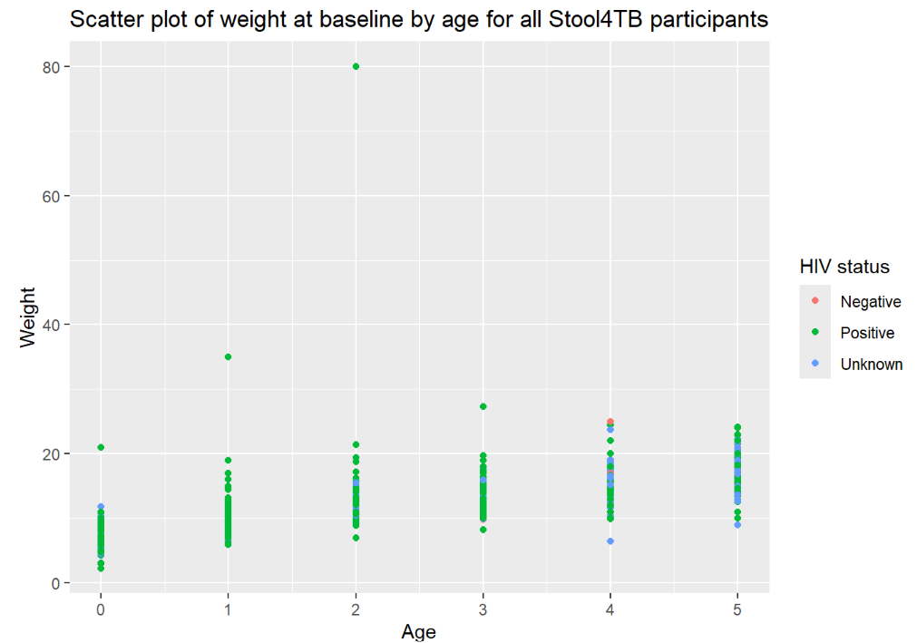
Please take a 10 minute break
We will reconvene at 3:30

